Slide 1


CLAUDE MASTERCLASS

Slide 2



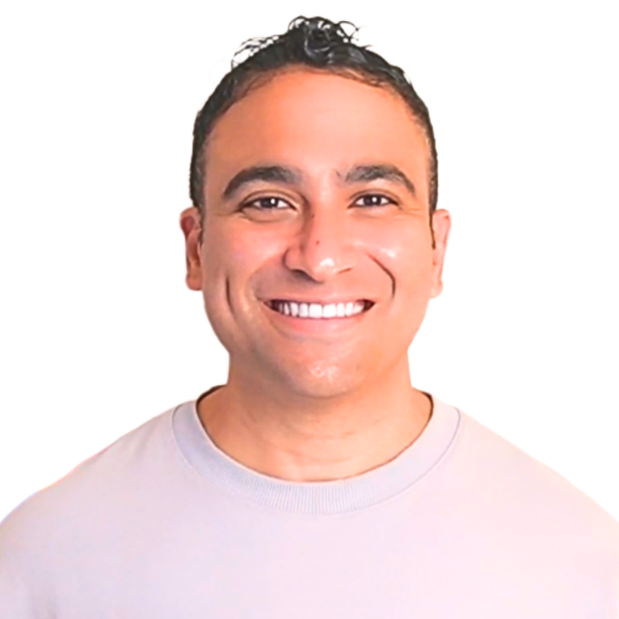





Instructor Introduction
530,000+ Students
M.A.Sc., Ph.D., MBA
260,000+ Subs, 3.5M views
Dr. Ryan Ahmed Professor & Best-selling Instructor
© All rights reserved for Dr. Ryan Ahmed @Stemplicity Inc.
AI & EV/AV
Taught L1 & 2 Python & AI

Slide 3
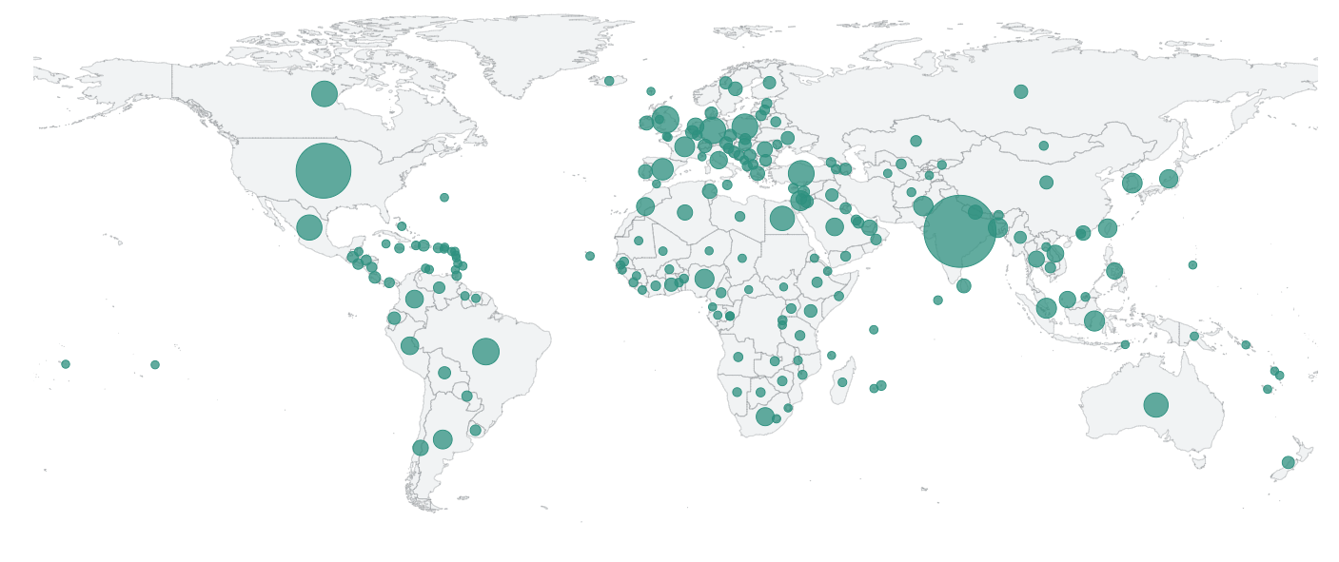











Global Students Reach
© All rights reserved for Dr. Ryan Ahmed @Stemplicity Inc.

Slide 4
“What if you could just... describe what you want and it happens?”
"Book me a Hotel in Tokyo,” and AI agents just do it…
© All rights reserved for Dr. Ryan Ahmed @Stemplicity Inc.

Slide 5





AI Agents
AI Agent
Book a hotel in Tokyo from April 1st to 4th
Planning
Tools
© All rights reserved for Dr. Ryan Ahmed @Stemplicity Inc.
Memory

Slide 6
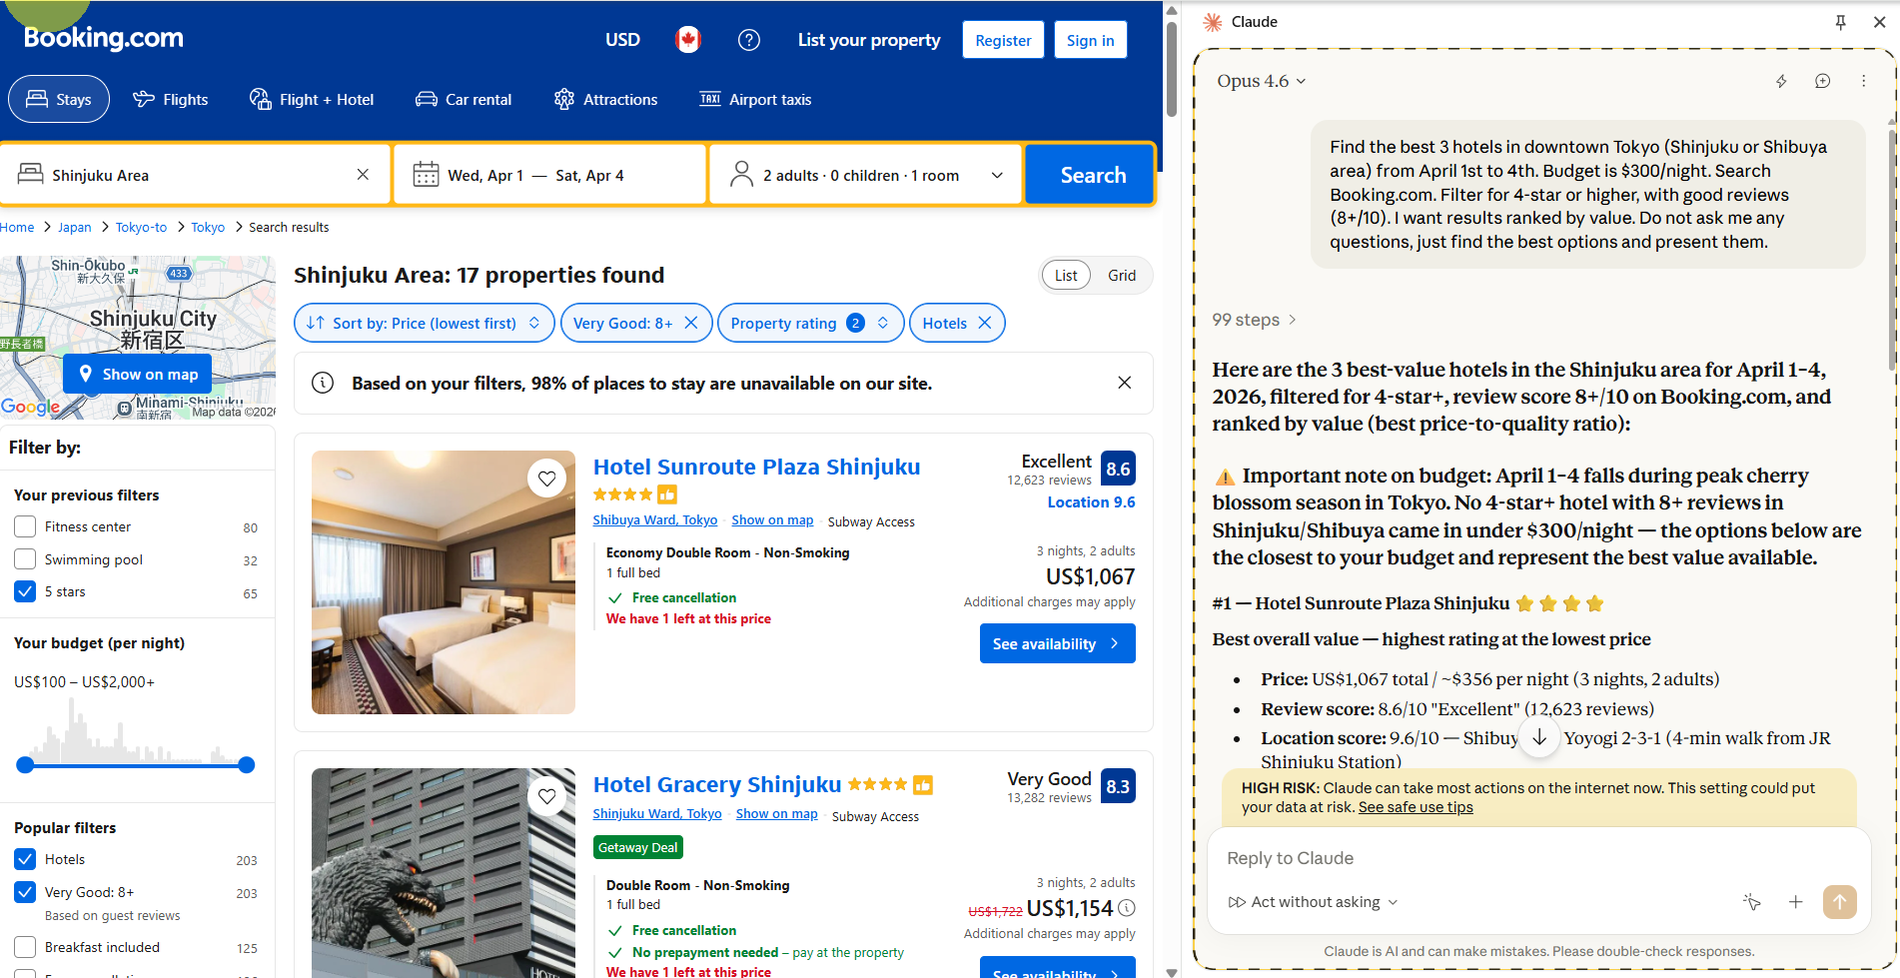
Claude Demo
© All rights reserved for Dr. Ryan Ahmed @Stemplicity Inc.

Slide 7
COURSE OUTLINE

Slide 8
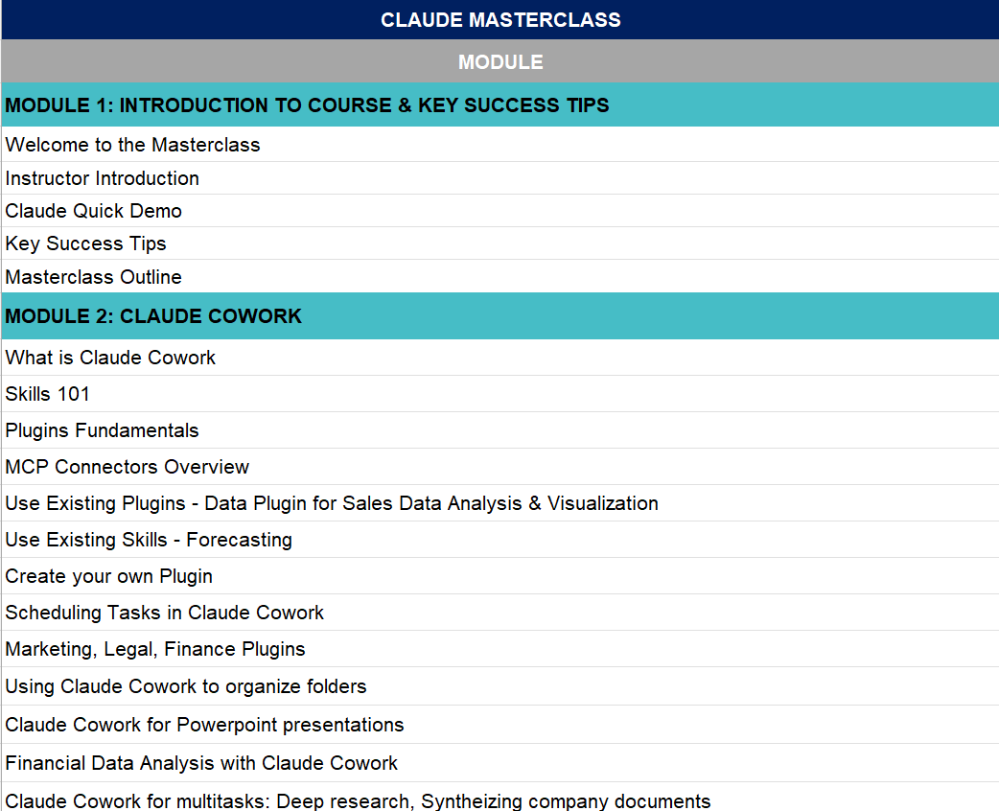
Course Outline
Check out the course outline “Claude Masterclass – Outline.xlsx”
© All rights reserved for Dr. Ryan Ahmed @Stemplicity Inc.

Slide 9
COURSE KEY SUCCESS TIPS

Slide 10
Success Tips
Learn by Doing!
Build a Portfolio of Projects
Solve Practice Opportunities
Leverage LinkedIn to share your work & maximize Reach!
© All rights reserved for Dr. Ryan Ahmed @Stemplicity Inc.
LinkedIn Link: https://www.linkedin.com/in/dr-ryan-ahmed/

Slide 11
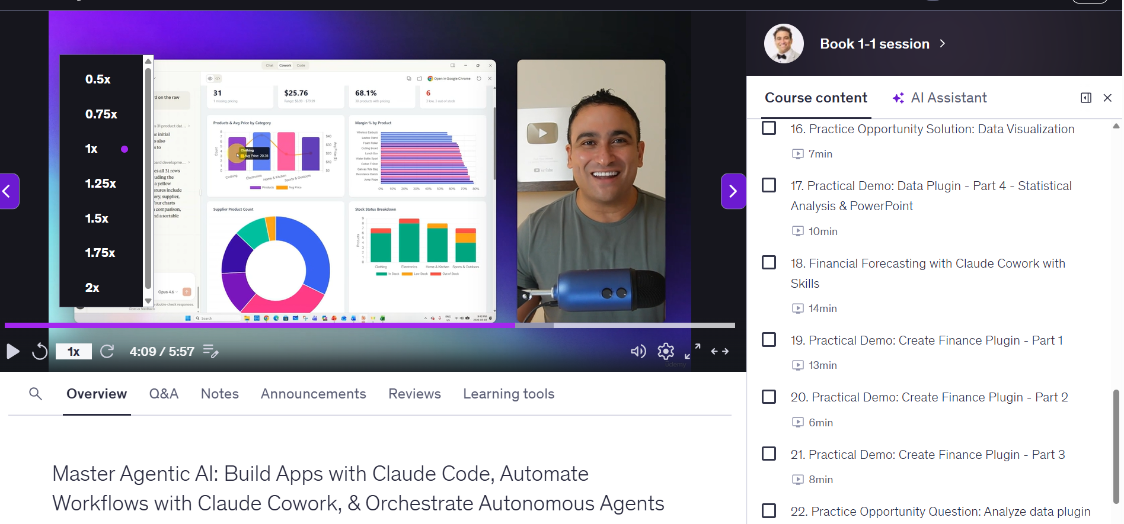
Change video Speeds
You have the option to play lectures at different speeds: (.5x, 1x, 1.25x, 1.5x or 2x)
In the bottom-left corner of the video, you can change the speed of the video.
© All rights reserved for Dr. Ryan Ahmed @Stemplicity Inc.

Slide 12
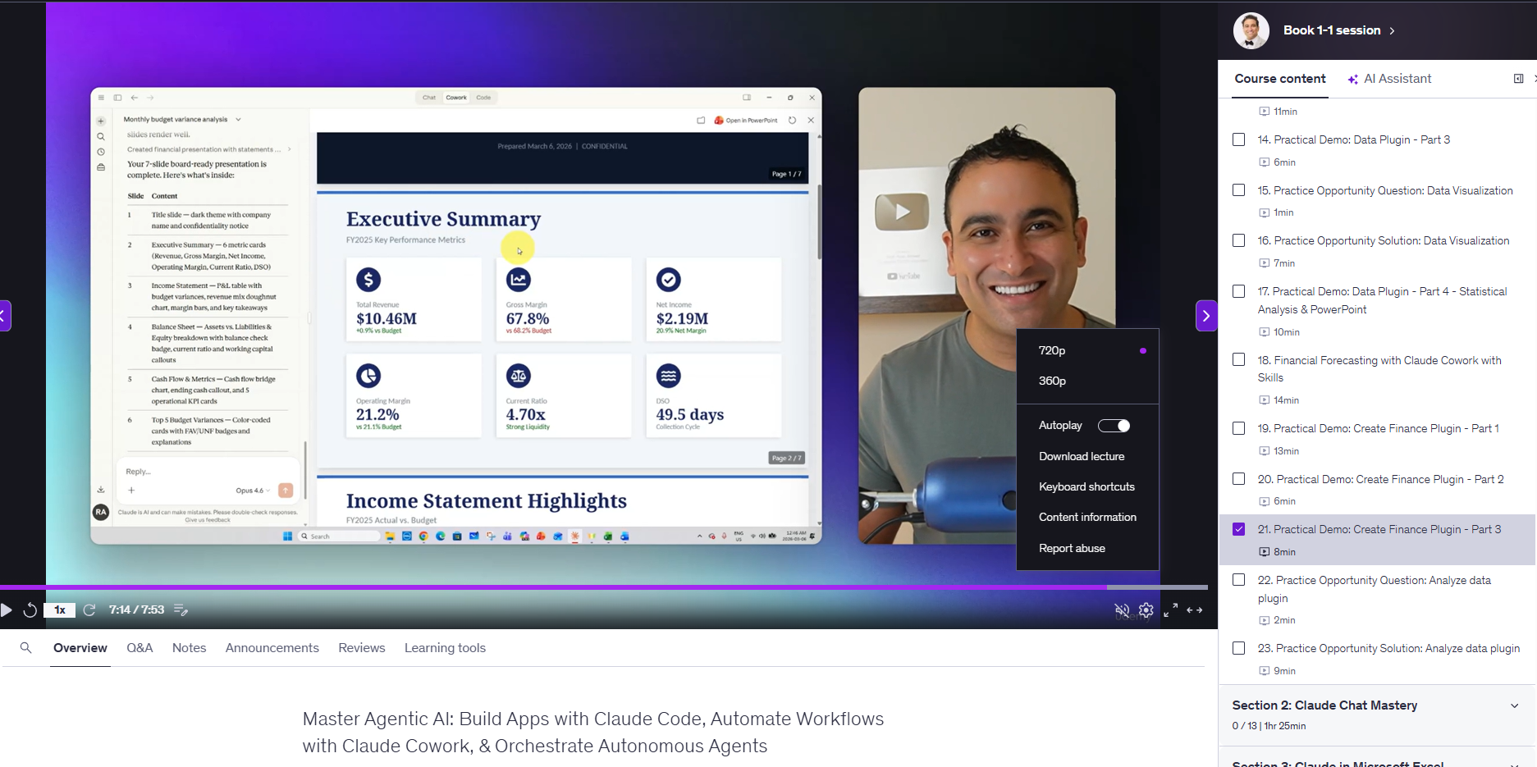
Change the video quality
Udemy automatically optimizes video resolution based on your internet connection speed. Alternatively, you can select 360p, 480p, and 720p resolutions for the video quality.
All course lectures are filmed with HD quality 1080p.
© All rights reserved for Dr. Ryan Ahmed @Stemplicity Inc.

Slide 13
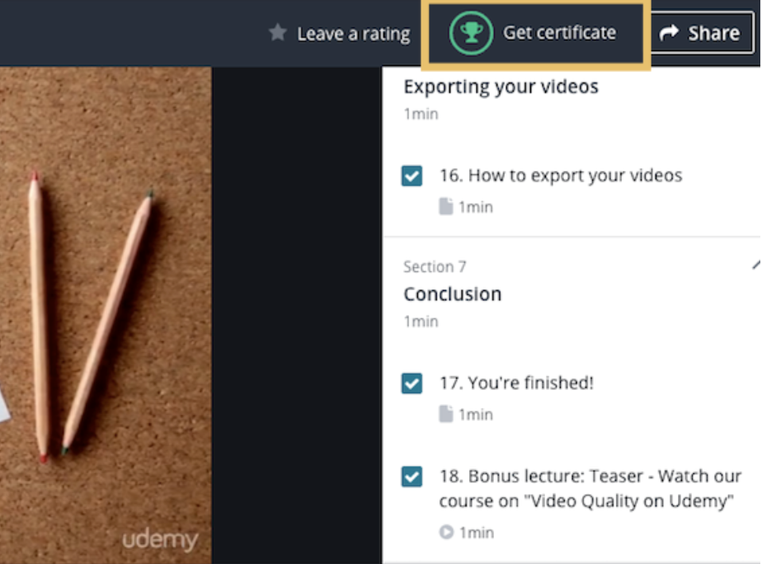
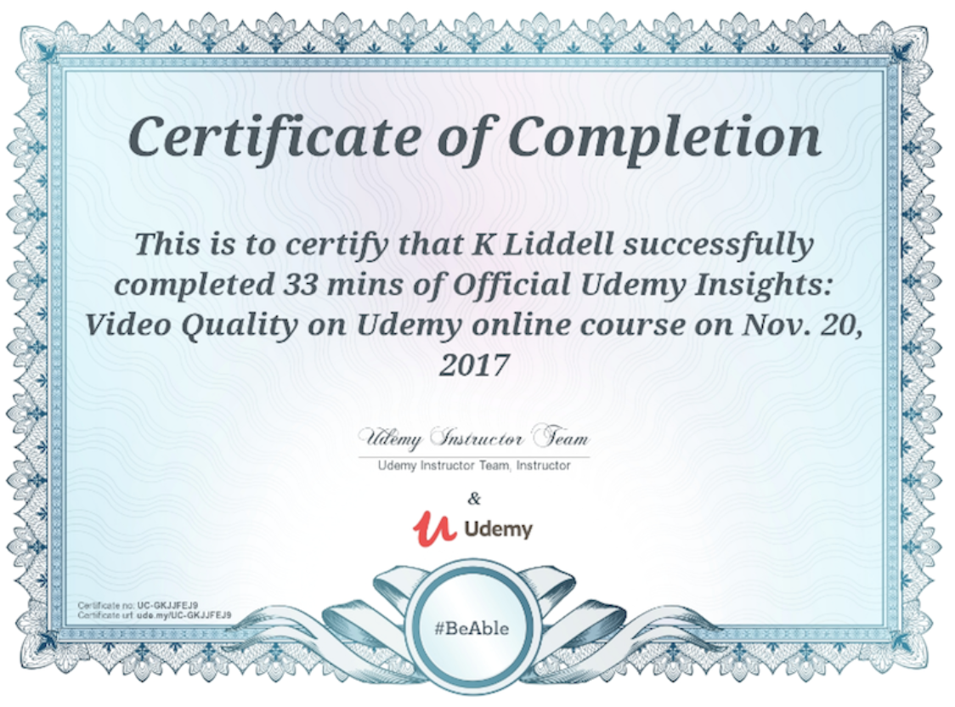
How do you get the Certificate of Completion?
When you complete all course modules, you will receive a certificate of completion.
© All rights reserved for Dr. Ryan Ahmed @Stemplicity Inc.

Slide 14
Thank you!

